Slide 1

SEAG Entrance Assessment 2025
Familiarisation
Principal: Dr A Donnelly

Slide 2
                We have emailed the following documents to parents (8 October 2025):
“SEAG Expectations of Parents and Pupils” including
“What if” Scenarios 2025.
“FAQs for parents whose Children will sit the
SEAG Entrance Assessment 2025”.
We will email parents with information on
drop-off / pick-up times
and arrangements for the day.

Slide 3
Pupil Cards are available for download on the SEAG website.

Slide 4
It’s just another school day,
wear your school uniform,
it helps to get you in the right frame of mind.

Slide 5
We do the Assessments in classrooms, supervised by our staff, and in each room we have up to 20 pupils.
We will look after everybody from when your parents arrive with you until they pick you up again.
We will have a lot of friendly faces about to take care of you: teachers, learning support and student prefects.
You cannot get lost on the morning – we have so many people here to look after you – no need to worry, there will always be someone there to help you out.

Slide 6
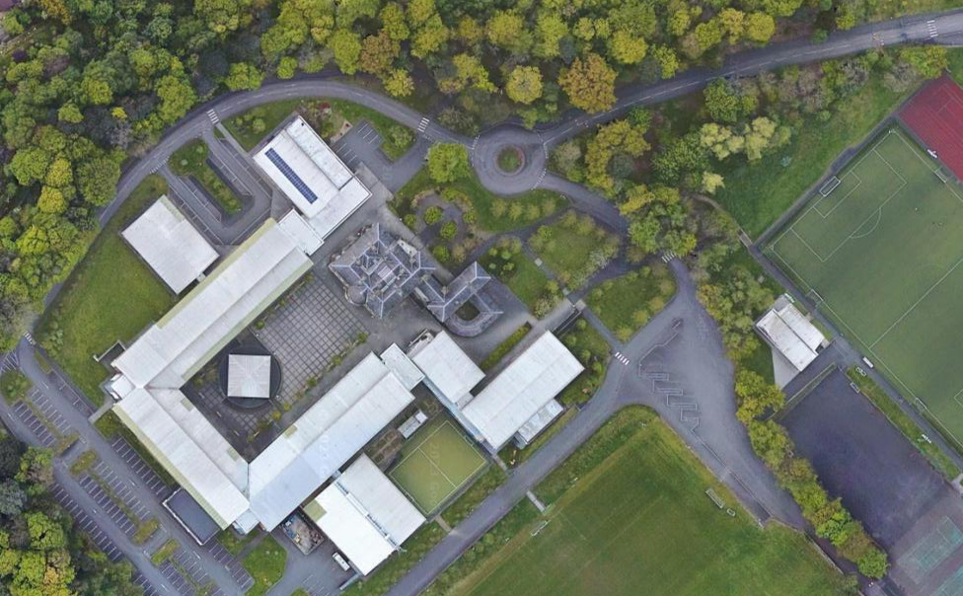
People will be on hand to collect the children from you when you drop them off at the school foyer.
Parking as directed by Caretakers

Slide 7
The Entrance Assessment consists of two Assessment Papers taken a week apart, 15 and 22 of November.
Two sharpened HB pencils, an eraser and blank sheets of paper for “working out” will be provided.
Highlighters are permitted but must not be used on the Answer sheet.
Rulers*, calculators, mobile phones, earbuds, watches/ Smartwatches and other electronic devices are not permitted.
Water will be provided, do not bring any food or drink.

Slide 8
DETAILS OF ASSESSMENTS
The Paper starts with a Practice section, about 15 minutes long, containing 5 English questions and 5 Maths questions.
This allows pupils time to settle and to practise answering the same types of questions as those in the Main Paper but without those questions being marked or timed.
The actual assessment, 60 minutes long, consists of an English section which has 28 questions and then a Maths section which also has 28 questions.

Slide 9
56 questions in 60 minutes*
English: Q1 - Q28
Maths: Q29 - Q56
Multiple choice and free response (see official SEAG Practice Papers 1 and 2)
Work quickly and carefully
Extra time is not allowed for a toilet break. It will be allocated for sickness/distress.

Slide 10
There will be a clock at the front of the room.
Pupils are told the start time and finishing time.
The Invigilator will advise all pupils about the time:
- when they are about halfway through;
- when they have about 20 minutes left;
- when they have about 10 minutes left.
After 60* minutes, pupils will be told to stop, put their pencils down and not to talk.
* Timings will differ for pupils with extra time allowed.

Slide 11
ASSESSMENT DAY(S)
Schedule for each day: 15 and 22 November 2025
Procedure | Normal Timings |  | Additional Time Pupils
Children are settled in their assessment location | 09.40 - 10.00 |  | 09.40 - 10.00
Preamble + Practice Test | 10.00 - 10.15 |  | 10.00 - 10.15
Main Test | 10.15 - 11.15 |  | 10.15 - 11.30
Children escorted from their location in phased manner | 11.15 - 11.35 |  | 11.30 - 11.45

Slide 12
People will be on hand to collect the children from you when you drop them off at the school foyer.
Parking as directed by Caretakers

Slide 13
Your child should arrive at the Entrance Assessment Centre between 9:30 am and 9:40 am on Saturday 15 November 2025 and on Saturday 22 November 2025.
Please leave your child outside the reception where staff will be on hand to guide the children to their rooms.
Your child may be collected after the Assessment at 11:30 am on Saturday 15 November 2025 and at the same time on Saturday 22 November 2025.
Please collect your child at the reception area where they were dropped off.
Please note that parents should not proceed beyond this point and that noise levels should be kept low.

Slide 14
KEY DATES
SEAG Assessment Dates:
Saturday 15 November 2025 – Assessment Paper 1
Saturday 22 November 2025 – Assessment Paper 2
SEAG Results: Saturday 24 January 2026
Re-mark: 26/1/26 – 4/2/26
Parents, please keep your phone close by on the two Saturday Assessment mornings AND advise the second, emergency contact to do the same.

Slide 15
Our Open Day is on Saturday 17 January 2026 from 9:30 am to 1:00 pm.
If you have any queries regarding entrance criteria, ring me.
We are a family school, but we do take in new families every year.
Typically, more than half of our intake to Year 8
will be from new families.

Slide 16


